Slide 1
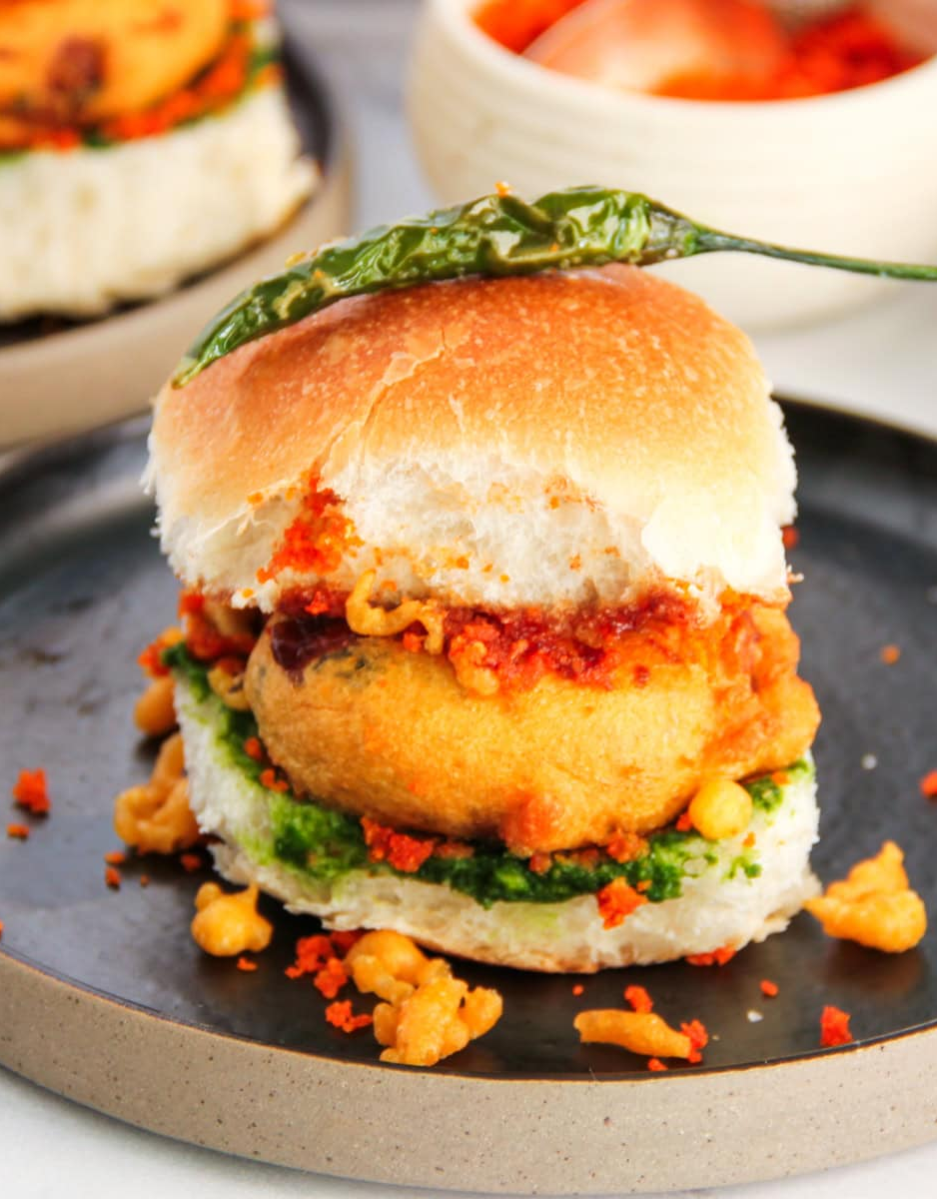
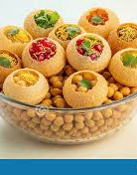
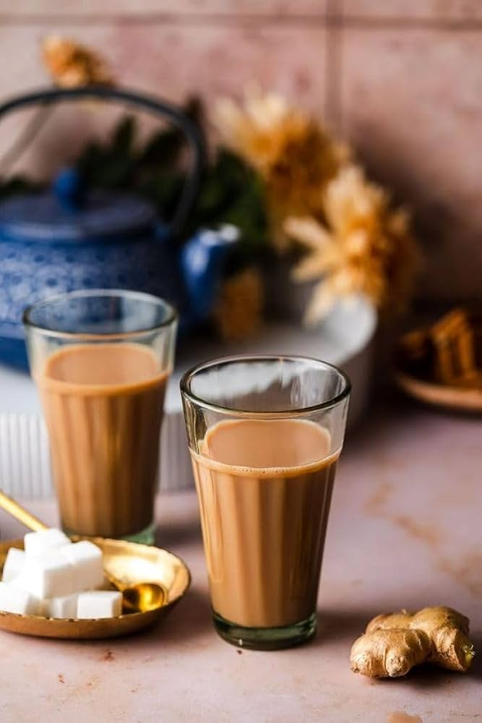
INDIAN STREET FOOD
Notes:
NOTE: To replace a picture, just select and delete it. Then use the Insert Picture icon to replace it with one of your own!

Slide 2
WEST AND SOUTH INDIAN TASTE
The Hustle (West): Mumbai’s Vada Pav is the ultimate "grab-and-go" food for a busy city. Pav Bhaji is the go-to comfort meal.
The Crispy Heritage (South): Focused on fermented rice/lentil batters. The Dosa has evolved from simple potato fillings to "99 varieties" including cheese and paneer.
Flavor Profile: Coconut, curry leaves, and mustard seeds dominate the South.

Slide 3

NORTH INDIAN TASTE
The Palette: A balance of creamy textures and warm spices (like cinnamon, cardamom, and cumin). It is less about "tongue-burning" heat and more about deep, savory fragrance.
The Core: Heavy use of dairy (ghee, butter, cream, and paneer) and a preference for wheat-based breads (Naan, Roti, Paratha) over rice.
The Technique: Much of the flavor comes from the Tandoor (clay oven), which adds a distinct smoky char to meats and breads.
Signature Taste: The "Golden Trio" of onion, tomato, and ginger-garlic paste forms the base of almost every iconic gravy.

Slide 4
EAST INDIAN TASTE
The Palette: A unique balance of sweet and tart, characterized by the sharp kick of mustard oil and the aromatic Panch Phoron (five-spice blend).
The Core: Primarily rice-based and centered around freshwater fish and greens. It is generally lighter and less oily than North Indian food.
The Technique: Focuses on steaming, boiling, and fermenting (like Panta Bhat) to preserve natural flavors.
Signature Taste: The use of poppy seeds (Posto) for creaminess and a

Slide 5
THANK YOU
MADE BY : SHARAD SHETTAR
VEDANT JADHAV

